Slide 1
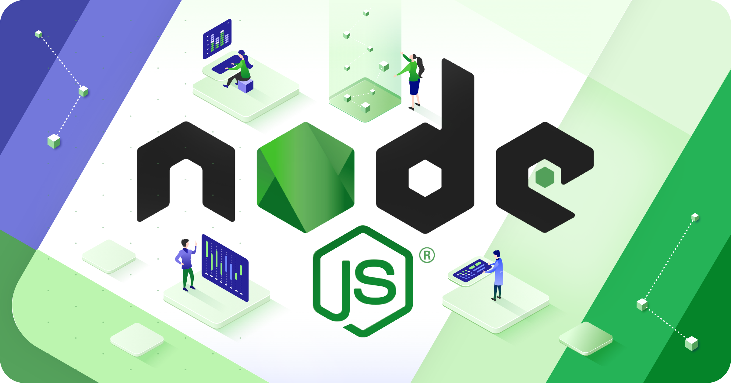

Slide 2
About Today…
Intro to Database
PostgreSQL Overview
Connecting to PostgreSQL
Interacting with PostgreSQL

Slide 3
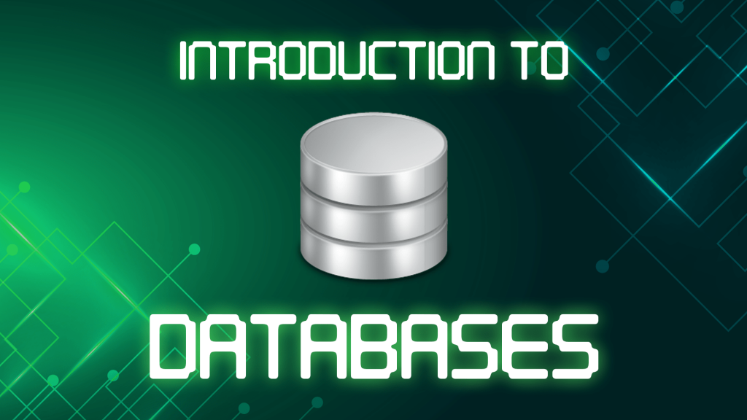

Slide 4
Database
Definition
Structured collection of data that is organized and stored in a computer system
Importance
Essential for storing and managing data in software applications
Provide a structured way to store information
Enable data consistency and integrity
Support various operations like querying, updating, and deleting data

Slide 5
Intro to PostgreSQL
Overview
Powerful, open-source relational database management system
Known for its reliability, scalability, and extensibility
Supports SQL (Structured Query Language) for managing data
Features
Support for complex queries
Triggers
Data integrity constraints
Full-text search
User-defined functions
JSON and XML support

Slide 6
Applications of PostgreSQL
Web Applications
Used as a backend database for web applications, Stores user data,
manages content, and handles transactions for websites and online platforms
Data Warehousing
Used for data warehousing, which involves collecting and managing
large volumes of data for analysis and reporting purposes
Geospatial Applications
Excellent support for geospatial data, making it ideal for applications
that deal with maps, location-based services, and geographic information systems
Financial Systems
Used for managing financial data, processing transactions, and generating
reports due to its reliability, security, and support for complex queries
Scientific Research
Used in scientific research for storing and analyzing experimental
data, conducting simulations, and managing research databases

Slide 7
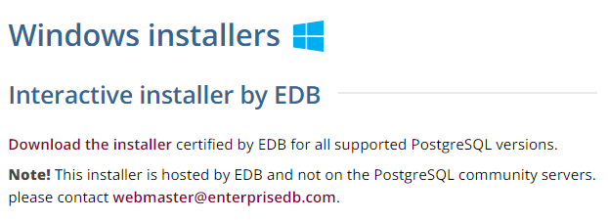
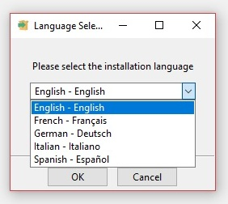
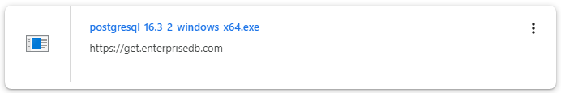
Installing PostgreSQL
Follow the URL :
https://www.postgresql.org/download/windows/

Slide 8
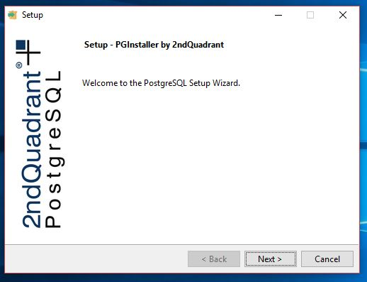
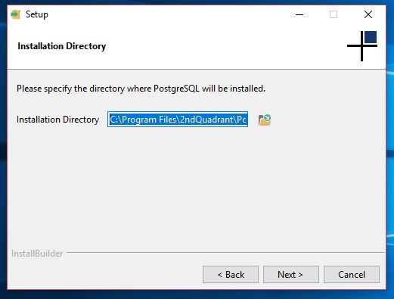
Installing PostgreSQL

Slide 9
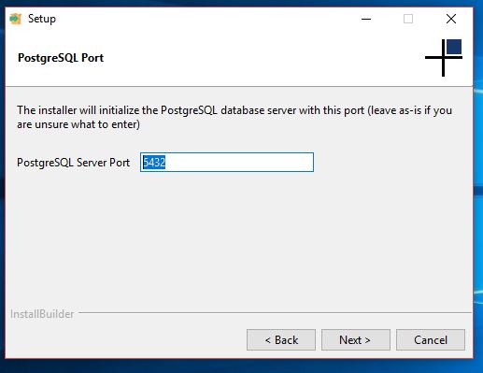
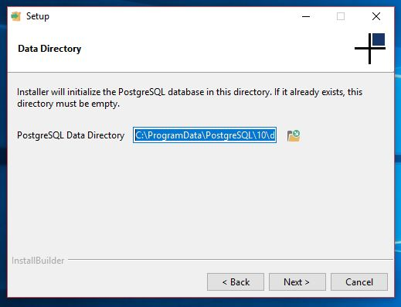
Installing PostgreSQL

Slide 10
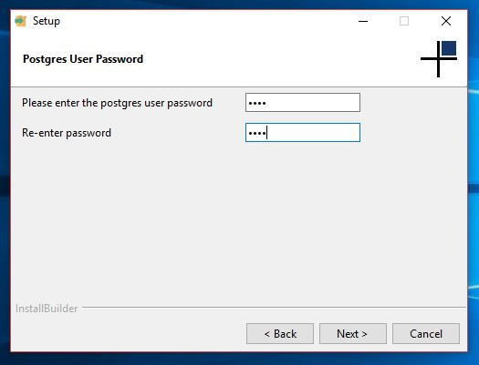
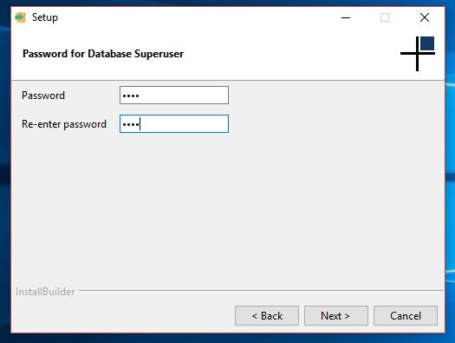
Installing PostgreSQL

Slide 11
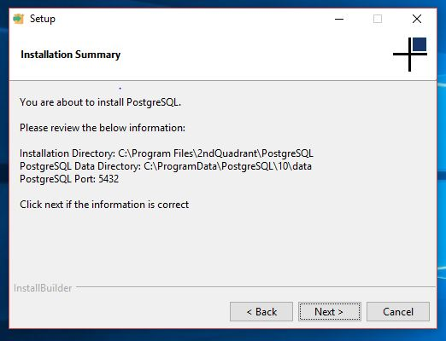
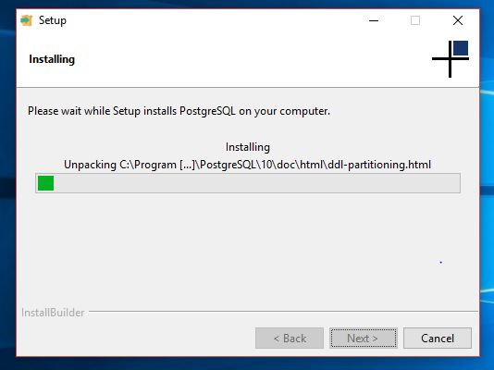
Installing PostgreSQL

Slide 12
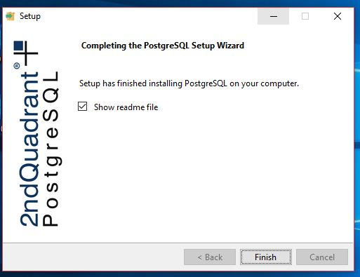
Installing PostgreSQL

Slide 13
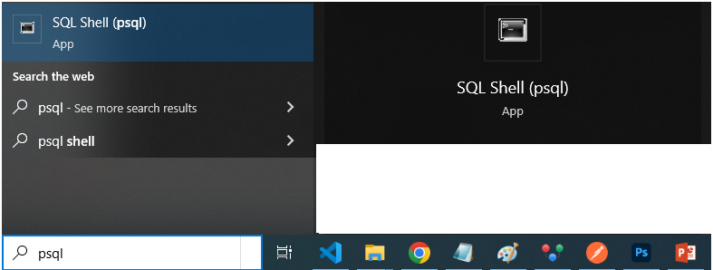
Accessing PostgreSQL

Slide 14
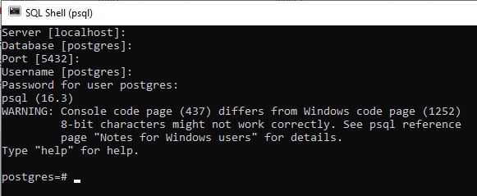
Connecting to PostgreSQL

Slide 15
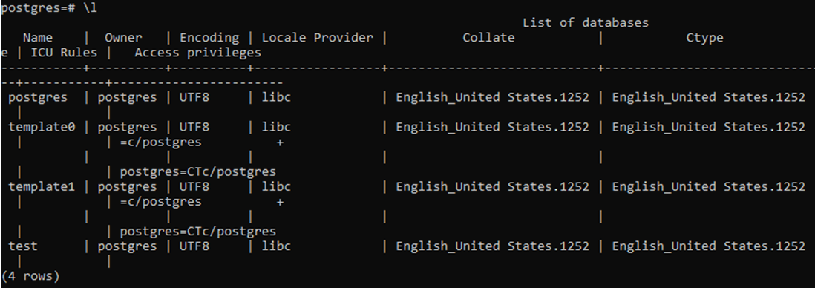
Creating new “test” database
Showing list of database

Slide 16

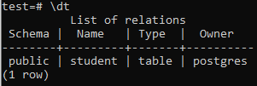
Connecting to “test” database
Creating new “student” table
Checking tables in database

Slide 17


Connecting app to PostgreSQL
Initialize Node project
Install PostgreSQL in Node.js

Slide 18
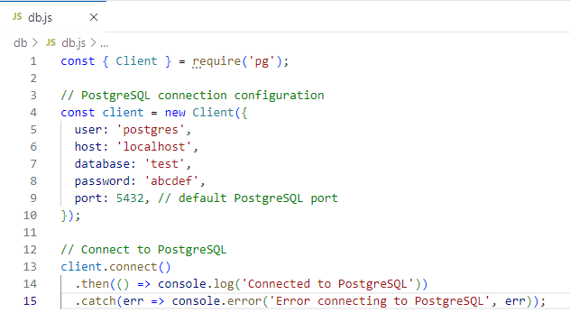
Code to connect database

Slide 19

Verifying database connection

